Slide 1
Git 101
Or,
How to sanely manage your Koha customizations

Slide 2
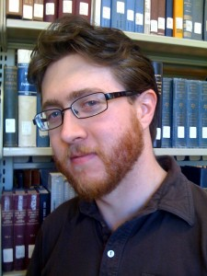
Who am I?
Ian Walls
Lead Development Specialist at ByWater Solutions
Koha 3.6 QA Manager
Geek

Slide 3


What is Git?
Git is a free and open source distributed version control system invented by Linus Torvalds (the Linux guy).

Slide 4
Why Git?
Distributed: everyone has the complete history of changes to the project stored locally
Manages content, not files
Multiple development lines can be followed concurrently

Slide 5
Basic Terminology
Repository (repo): the complete history of the project
Index: the current file contents you have
Commit: a saved change to the Index
Branch: a chain of Commits
Checkout: to choose a Commit, and load the Index associated with it
Patch: a Commit formatted as a file (for sending to others)

Slide 6
Repository Structure
commit
commit
commit
commit
kat
cat
cat
cat
dug
dug
dog
dog
bard
bard
bird
bird
rat

Slide 7
Branch Structure
HEAD
master
master
commit
commit
commit
commit
commit
merge
commit
commit
HEAD
HEAD
branch1
commit
commit
commit
branch2
merge
HEAD
commit
commit
branch3

Slide 8
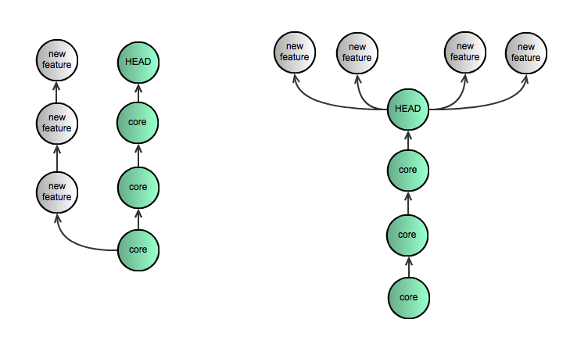
Bad repo v. Good repo

Slide 9
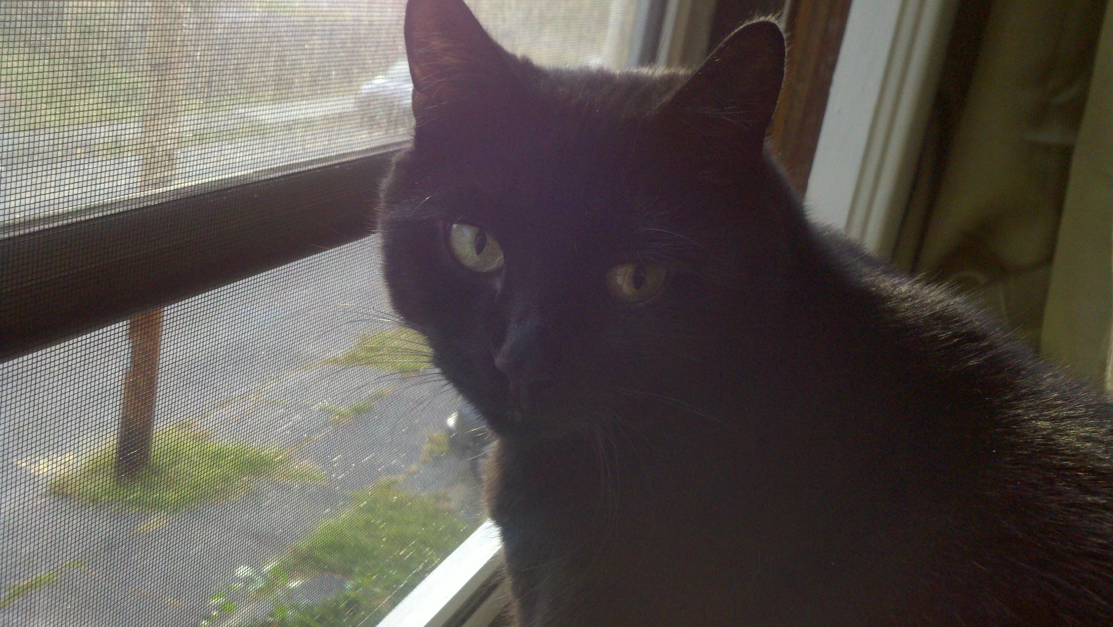
That's great...
Howz this aply to me?
Huwz this aply to me?

Slide 10
Git and Koha
Installation of Git
Cloning the Koha repository
Making a branch
Committing a change
Submitting a patch
Updating your repository
Signing off on others' patches

Slide 11
Installing Git
On Debian: sudo apt-get install git-core
On Ubuntu: sudo apt-get install git git-email
On Mac OSX: download git-osx-installer (http://code.google.com/p/git-osx-installer/)
On Windows: Don't.

Slide 12
Some quick Git config
git config --global user.name "your NAME"
git config --global user.email "your@mail.com"
Other configs are possible. All stored in: .gitconfig

Slide 13
Cloning the Koha repo
git clone git://git.koha-community.org/koha.git kohaclone
Wait...
cd kohaclone

Slide 14
Branching
Show all branches (current has *):
git branch
Show current branch and other info:
git status
Create your branch:
git checkout -b mybranch master

Slide 15
Finding something to fix
Talk to your librarians
Talk to your patrons
FILE A BUG REPORT!!! on http://bugs.koha-community.org
Bigger idea? Post an RFC on
http://wiki.koha-community.org

Slide 16
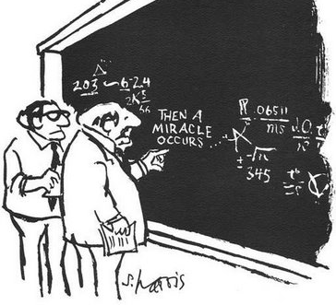
Making a Change

Slide 17
Committing a Change
For each file you changed:
  git add path/to/the.file
git commit
Or, more lazily: git commit -a
Write your commit message. It should begin with the bug number, then a brief one-line description of the bug.

Slide 18
Publishing your Commit
git format-patch master
You'll see something like “0001-BugXXXX--....fix.patch”
git send-email -to koha-patches@lists.koha-community.org “0001-BugXXXX--....fix.patch”

Slide 19
The Paperwork
File a bug report!
For bigger developments, post an RFC to the wiki with detailed functionality
After emailing patch, attach the patch to the bug report and label bug “needs signoff”
After signing off, label bug “signed off”. If the patch isn't attached to the bug report, do it now

Slide 20
Why the attachment?
Puts the solution with the problem; saves search in the patches list
Easy to fetch an attached patch:
wget -O bugXXXX.patch http://bugs.koha-community.org/bugzilla3/attachment.cgi?id=YYYY

Slide 21
Code Acceptance Process
Patch goes to patches listserv
Someone in the community tests and signs off
Quality Assurance Manager tests, and signs off
Release Manager commits to Koha

Slide 22
Keeping up with Changes
git checkout master
git pull
git checkout mybranch
git rebase master
You may need to deal with merge conflicts... Submit Early and Submit Often

Slide 23
Sign-offs
git am -i -u -3 bugXXXX.patch
(Tap 'y' to confirm)
TEST TEST TEST
git commit –-amend
change the first line of the commit message to begin with [SIGNED-OFF]
git format-patch -s master
git send-email ...

Slide 24
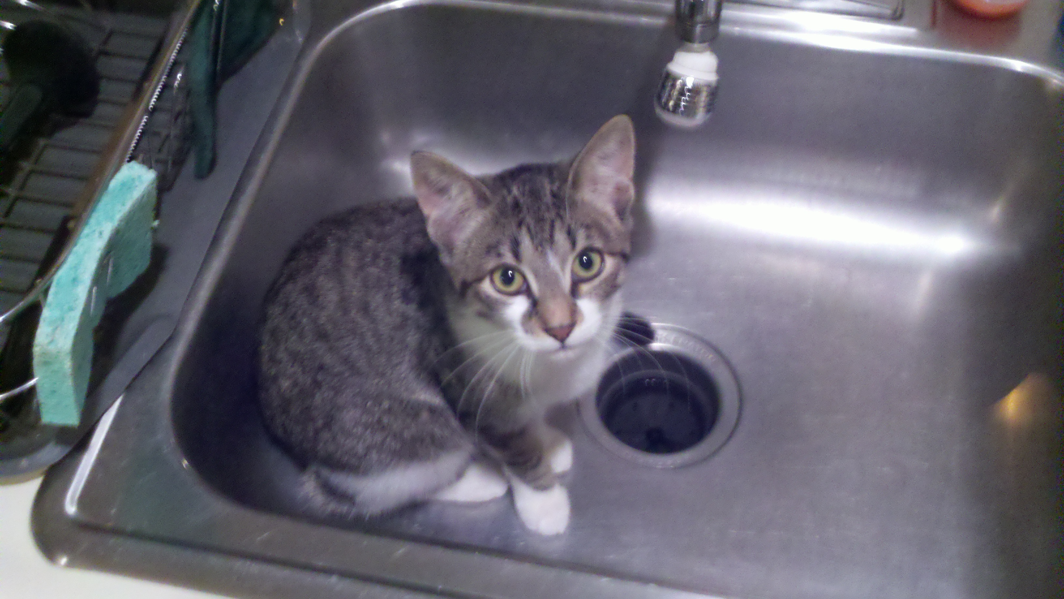
Course Complete!
I can haz diploma?
Teh sink ate yurs

Slide 25
Questions?
Checkout http://wiki.koha-community.org/wiki/Version_Control_Using_Git for more details
Log on to Koha IRC: we're here to help!

